Slide 1




Doubt Session - Statistics
Notes:
Good Morning everyone. Welcome to the session of Introduction to AIML
Today objective would be to know what is AIML, its imple-mentation along with type of models and its real life examples

Slide 2

My Journey
SDA Bocconi, Italy class of 2017 with Post Graduation in Analytics
Bachelor’s degree from NIT Surat, Schooling from K.V., where he was the house captain
10+ years of experience across L&T, Merck Pharmaceutical, OYO, Udaan & Zomato
Currently, Senior Manager at Zomato, working for Ads Monetization team
Notes:
A quick introduction about myself, I’m Shashank and I have 10+ yrs of work ex, I have worked with companies like L&T, merck, OYO, Udaan and currently working as a senior manager in Zomato. I passed out from NIT Surat in 2013 and I did post grad from SDA Bocconi in 2017

Slide 3
RECAP
Statistics
branch of mathematics that deals with the collection, analysis, interpretation, presentation, and organization of data.
Descriptive
Inferential
methods for summarizing and describing the features of a data set.
methods are used to make generalizations or predictions about a population based on a sample of data.
Measure of Central Measures
Measure of Variability
Sampling
Error (Bias)
Point & Range Estimation
describe the center or typical value within a data set.
Mean
Median
Mode
Quartiles
Percentile
provide information about the dispersion or spread of data points within a data set.
Range
Variance
Standard Deviation
used to select a subset of individuals, items, or data points from a larger population or dataset.
Random Sampling
Systematic Sampling
Stratified Sampling
refer to inaccuracies or deviations from the true value or state
Undercover Bias
Exclusion bias
Survivorship Bias
Provide the best value (single or range) based on the historical data
Central Limit Theorem
describes the characteristics of sampling distributions.
Notes:
Okay before we start Introduction to AIML session, can someone tell me what comes in your mind when you hear the word AIML.

Slide 4


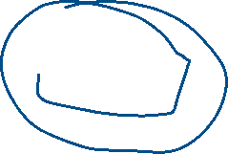









Slide 9


What is the mean of the numbers: 10, 20, 30, 40, and 50?
25
30
35
40
Notes:
Okay before we start Introduction to AIML session, can someone tell me what comes in your mind when you hear the word AIML.

Slide 10







What is the mode of the following dataset: 4, 5, 6, 6, 7, 8, 8, 8, 9?
6
7
8
9
Notes:
Okay before we start Introduction to AIML session, can someone tell me what comes in your mind when you hear the word AIML.

Slide 11


Q. Which of the following is NOT a measure of central tendency?
Mean
Mode
Range
Median
Notes:
Okay before we start Introduction to AIML session, can someone tell me what comes in your mind when you hear the word AIML.

Slide 12


Q. What is the difference between population and sample in statistics?
A sample includes the entire population
B) A population is a subset of a sample
C) A sample is a subset of a population
D) A sample and a population are the same
Notes:
Okay before we start Introduction to AIML session, can someone tell me what comes in your mind when you hear the word AIML.

Slide 13





Q. What is the main purpose of descriptive statistics?
To infer conclusions from a sample
To summarize and describe data
To conduct hypothesis testing
To predict future outcomes
Notes:
Okay before we start Introduction to AIML session, can someone tell me what comes in your mind when you hear the word AIML.

Slide 14


Q. Why is sampling important in statistics?
It allows researchers to study the entire population
It is easier and more cost-effective than studying the whole population
It always provides 100% accurate results
It eliminates bias completely
Notes:
Okay before we start Introduction to AIML session, can someone tell me what comes in your mind when you hear the word AIML.

Slide 15








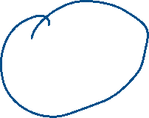






Q. What is random sampling?
Choosing participants based on convenience
Every individual has an equal chance of being selected
Selecting only people who meet a certain criterion
Choosing the first 10 people in a population
Notes:
Okay before we start Introduction to AIML session, can someone tell me what comes in your mind when you hear the word AIML.

Slide 16









What does the range of a dataset represent?
The average value of the dataset
The difference between the highest and lowest values
The middle value of the dataset
The most frequently occurring value
Notes:
Okay before we start Introduction to AIML session, can someone tell me what comes in your mind when you hear the word AIML.

Slide 17
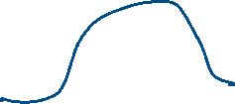



Which of the following is true about standard deviation?
It measures the spread of data
It is the same as variance
It is always greater than the mean
It is unaffected by outliers
Notes:
Okay before we start Introduction to AIML session, can someone tell me what comes in your mind when you hear the word AIML.

Slide 18



What does the Central Limit Theorem (CLT) state?
The sum of data is always normally distributed
The distribution of sample means approaches normality as the sample size increases
The mean of a population is always equal to the sample mean
Every dataset is normally distributed
Notes:
Okay before we start Introduction to AIML session, can someone tell me what comes in your mind when you hear the word AIML.

Slide 19




If the first quartile (Q1) = 20 and third quartile (Q3) = 50, what is the interquartile range (IQR)?
20
30
50
70
Notes:
Okay before we start Introduction to AIML session, can someone tell me what comes in your mind when you hear the word AIML.

Slide 20




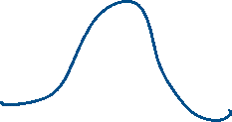
What does a high variance indicate about the data?
The data points are close to the mean
The data points are spread out from the mean
The data set has no outliers
The mean is higher than the median
Notes:
Okay before we start Introduction to AIML session, can someone tell me what comes in your mind when you hear the word AIML.

Slide 21



How does systematic sampling differ from random sampling?
It selects samples at regular intervals
It selects samples using a random number generator
It only selects the first available samples
It is less efficient than convenience sampling
Notes:
Okay before we start Introduction to AIML session, can someone tell me what comes in your mind when you hear the word AIML.

Slide 22






What type of bias occurs when only successful outcomes are considered, ignoring failures?
Exclusion bias
Survivorship bias
C) Selection bias
D) Recall bias
Notes:
Okay before we start Introduction to AIML session, can someone tell me what comes in your mind when you hear the word AIML.

Slide 23
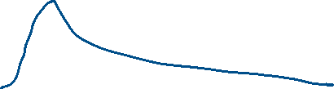







A dataset has a median of 30 and a mean of 40. What does this suggest?
The data is skewed left
The data is skewed right
The data is symmetric
The mode is greater than the median
Notes:
Okay before we start Introduction to AIML session, can someone tell me what comes in your mind when you hear the word AIML.

Slide 24







A survey conducted only among social media users leads to which type of bias?
Selection bias
Undercoverage bias
Measurement bias
Non-response bias
Notes:
Okay before we start Introduction to AIML session, can someone tell me what comes in your mind when you hear the word AIML.

Slide 25






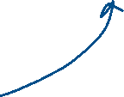





How does the Central Limit Theorem help in real-world scenarios?
It ensures data is normally distributed
It allows us to use sample statistics to estimate population parameters
It guarantees equal probability for all sample points
It proves variance is always constant
Notes:
Okay before we start Introduction to AIML session, can someone tell me what comes in your mind when you hear the word AIML.

Slide 26












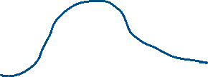
A 95% confidence interval for the mean height of a group of students is (165 cm, 175 cm). What does this mean?
The true mean height is definitely in this range
There is a 95% chance that the sample mean is between 165 and 175 cm
There is a 95% chance that the population mean falls within this range
The sample mean is always exactly 170 cm
Notes:
Okay before we start Introduction to AIML session, can someone tell me what comes in your mind when you hear the word AIML.

Slide 27




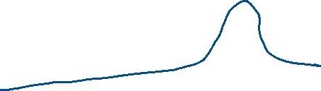
If a dataset is skewed left (negative skew), which measure of central tendency is the largest?
Mean
Median
Mode
They are all equal
Notes:
Okay before we start Introduction to AIML session, can someone tell me what comes in your mind when you hear the word AIML.

Slide 28


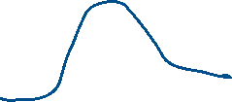




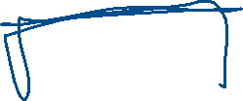

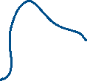









If you take multiple random samples from a population, the means of these samples will form a distribution that follows:
A binomial distribution
A uniform distribution
A normal distribution
A skewed distribution
Notes:
Okay before we start Introduction to AIML session, can someone tell me what comes in your mind when you hear the word AIML.

Slide 29
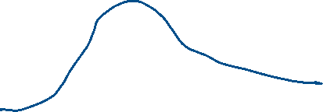





What is the impact of increasing the confidence level from 95% to 99%?
The confidence interval becomes wider
The confidence interval becomes narrower
The standard error decreases
The mean increases
Notes:
Okay before we start Introduction to AIML session, can someone tell me what comes in your mind when you hear the word AIML.

Slide 30





















If a researcher selects only extreme values while ignoring moderate values, what type of bias is introduced?
Exclusion bias
Selection bias
Outlier bias
Measurement bias
Notes:
Okay before we start Introduction to AIML session, can someone tell me what comes in your mind when you hear the word AIML.

